Slide 1


Tractor Market Exchange
2021 Q3

Slide 2
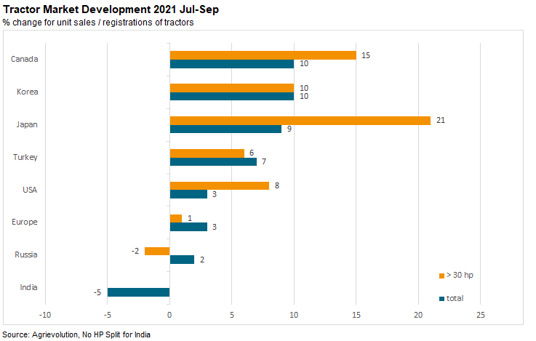

Slide 3
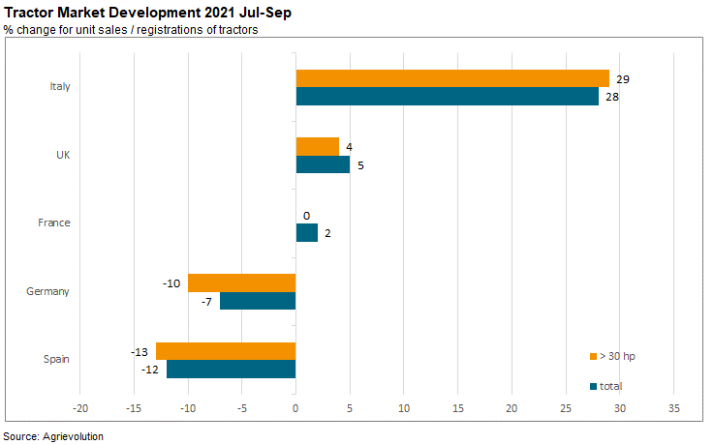

Slide 4
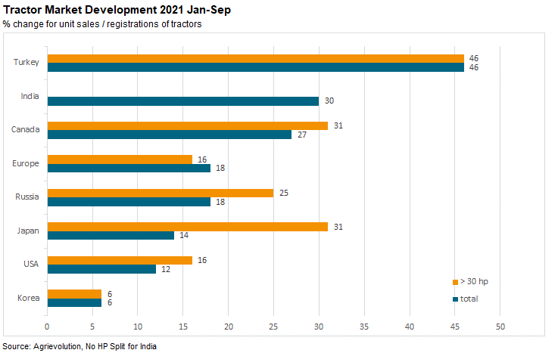

Slide 5
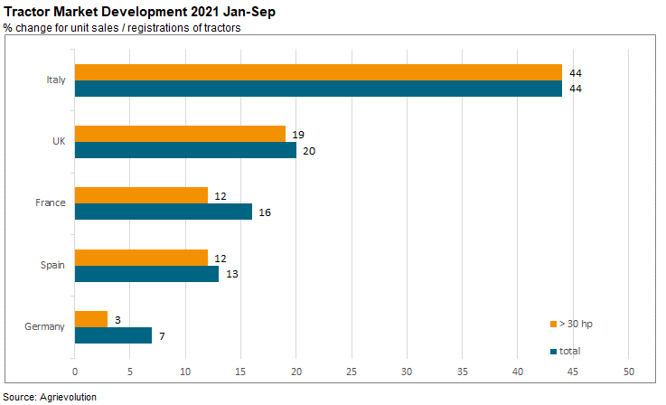

Slide 6

Dates for the Tractor Market Exchange
quarterly
next deadlines for sending the data to the secretariat:
  20th January 2022
  20th April 2022
  20th July 2022
  20th October 2022

